Slide 1

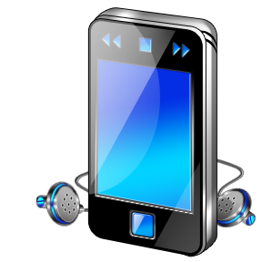

F
I
R
S
T
C
O
R
N
A
N
I
T
H
I
S
4
.
-
21
9
A free CD of this message will be available following the service
It will also be available for podcast later this week at calvaryokc.com

Slide 2
¹⁶ So then, because you are lukewarm, and neither cold nor hot, I will vomit you out of My mouth.
¹⁷ Because you say, "I am rich, have become wealthy, and have need of nothing '— and do not know that you are wretched, miserable, poor, blind, and naked —
Rev. 3.16-17 –
Rev. 3.17 –
O
A
N
S
4.8-21
I
I
F
I
R
S
T
C
R
N
T
H

Slide 3
Rev. 3.18 - I counsel you to buy from Me gold refined in the fire, that you may be rich; and white garments, that you may be clothed, that the shame of your nakedness may not be revealed; and anoint your eyes with eye salve, that you may see.
O
A
N
S
4.8-21
I
I
F
I
R
S
T
C
R
N
T
H

Slide 4
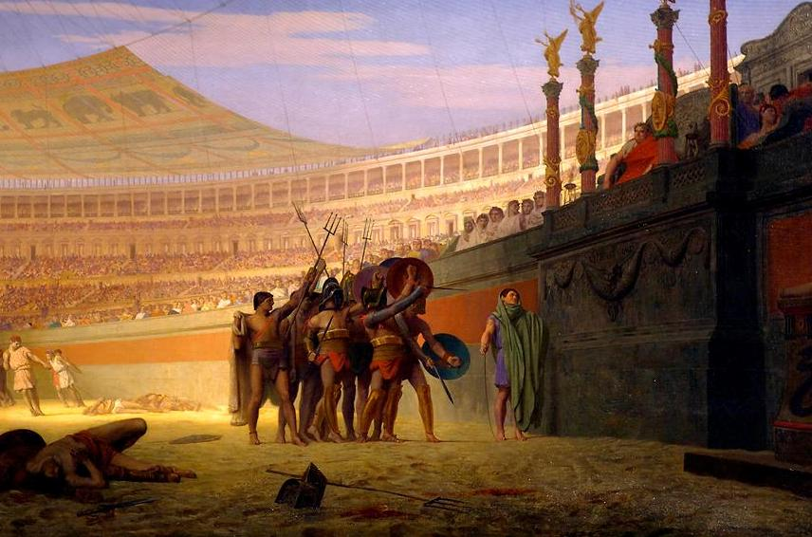
Spectacle - theatron
“Hail Caesar! We who are about to die, salute you.”
“Ave, Caesar! morituri te salutamus.”
O
A
N
S
4.8-21
I
I
F
I
R
S
T
C
R
N
T
H

Slide 5
1 Thess. 5.12-13 - ¹² And we urge you, brethren, to recognize those who labor among you, and are over you in the Lord and admonish you, ¹³ and to esteem them very highly in love for their work's sake. Be at peace among yourselves.
O
A
N
S
4.8-21
I
I
F
I
R
S
T
C
R
N
T
H

Slide 6
“When we obey God, we’re not doing it for God - we’re doing it for ourselves - because God takes pleasure when we’re happy … When you come to church, when you worship God, you’re not doing it for God - you’re doing it for yourself because that’s what makes God happy. Amen?”
O
A
N
S
4.8-21
I
I
F
I
R
S
T
C
R
N
T
H

Slide 7
Entreat: parakaleō – comfort
Offscouring - NASB, dregs; NIV, refuse
Literally, Plate-scrapings
O
A
N
S
4.8-21
I
I
F
I
R
S
T
C
R
N
T
H

Slide 8
Imitate - mimētēs
O
A
N
S
4.8-21
I
I
F
I
R
S
T
C
R
N
T
H

Slide 9
Francis Shaeffer - “Love of God & Purity of God: - If we show either of these without the other, we exhibit not the character, but a caricature of God.”
O
A
N
S
4.8-21
I
I
F
I
R
S
T
C
R
N
T
H

Slide 10
Words of Removal:
Matt. 18.15-17 - ¹⁵ Moreover if your brother sins against you, go and tell him his fault between you and him alone. If he hears you, you have gained your brother. ¹⁶ But if he will not hear, take with you one or two more, that “by the mouth of two
O
A
N
S
4.8-21
I
I
F
I
R
S
T
C
R
N
T
H

Slide 11
Words of Removal:
or three witnesses every word may be established.” ¹⁷ And if he refuses to hear them, tell it to the church. But if he refuses even to hear the church, let him be to you like a heathen and a tax collector.
O
A
N
S
4.8-21
I
I
F
I
R
S
T
C
R
N
T
H

Slide 12
Words of Restoration:
James 5.19-20 - ¹⁹ Brethren, if anyone among you wanders from the truth, and someone turns him back, ²⁰ let him know that he who turns a sinner from the error of his way will save a soul from death and cover a multitude of sins.
O
A
N
S
4.8-21
I
I
F
I
R
S
T
C
R
N
T
H

Slide 13
Words of
Words of
Church
Removal
Restoration
O
A
N
S
4.8-21
I
I
F
I
R
S
T
C
R
N
T
H

